Slide 1
Trees
[Module – 4]
WCE - SY (CSE) – CS 212: Data Structures and Files
Subject Teacher: Smriti Bhandari

Slide 2
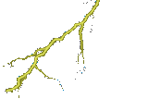


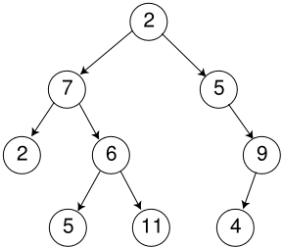





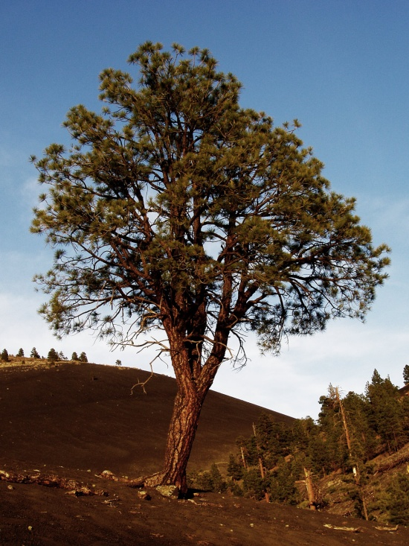








Trees

Slide 3
Nature Lover’s View Of A Tree
leaves
branches
root

Slide 4

Computer Scientist’s View
root
leaves
branches
nodes

Slide 5
Trees
Basic Terminology
Binary Trees and their representation
Binary tree traversal
Operations on binary tree
Notes:
A data structure is linear if every item is related (or attatched) to its previous and next item(e.g.array, linked list) and it is non-linear if every item is attached to many other items in specific ways to reflect relationships(e.g, n-ary tree). In linear data structure data items are arranged in a linear sequence. In non-linear data structure data items are not in a sequence.
Linear data structure: A linear data structure traverses the data elements sequentially, in which only one data element can directly be reached. Ex: Arrays, Linked Lists
Non-Linear data structure: Every data item is attached to several other data items in a way that is specific for reflecting relationships. The data items are not arranged in a sequential structure. Ex: Trees, Graphs

Slide 6
Linear Lists Vs Trees
Linear lists are useful for serially ordered data
  (e₁,e₂,e₃,…,e_{n})
  Days of week
  Months in a year
  Students in a class
Trees are useful for hierarchically ordered data
  Corporate structure
  Government Subdivisions
  Software structure

Slide 7
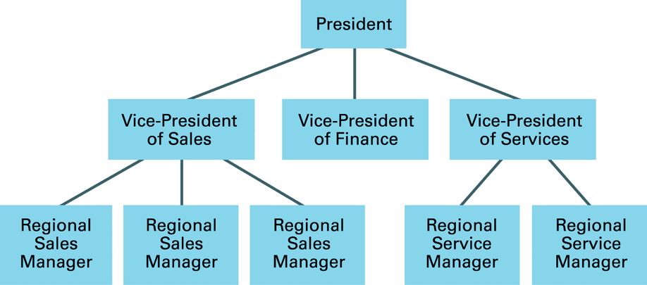
Example of Tree

Slide 8
Basic Terminology
Tree consists of
  Finite set of elements called Nodes
  Finite set of directed lines called branches that connect the nodes
A
Node
B
E
F
Branch
C
D
G
H
I

Slide 9
Basic Terminology – (2)
Degree of node
  Number of branches associated with a node
  E.g. Degree of node B is 3
Indegree branch for node B
A
Node
B
E
F
Branch
C
D
G
H
I
Outdegree branches for node B
Degree of Node = Σ (indegree branches) + Σ (outdegree branches)

Slide 10
Basic Terminology – (3)
For non-empty tree, the first node is called the root.
Indegree of root = 0
All the nodes (except root) have indegree = 1
Outdegree of node = 0, 1 or more
Root
A
Node
B
E
F
Branch
C
D
G
H
I

Slide 11
Basic Terminology – (4)
The element at the top of the hierarchy is the root.
Elements next in the hierarchy are the children of the root.
Elements at the lowest level of the hierarchy are the leaves.
Root
A
Node
B
E
F
Branch
C
D
G
H
I

Slide 12
Basic Terminology – (5)
Leaf (Terminal Node) – node with an outdegree zero i.e. node with no successor
Internal node – node that is not a root or leaf
Parent – node that has successor nodes i.e. outdegree greater than zero
Child – node with a predecessor i.e. indegree of one
Siblings – nodes with the same parent

Slide 13
Basic Terminology – (6)
Ancestor – any node in the path from the root to the node
Descendent – any node in the path below the parent node i.e. all nodes in the paths from a given node to a leaf are descendent to that node
Path – sequence of nodes in which each node is adjacent to the next one
Level of a node is its distance from the root (Level of root is 0)
Height of tree is the level of the leaf in the longest path from the root plus 1
Subtree – any connected structure below the root

Slide 14
Basic Terminology – (7)
Root = A
Leaves = {C,D,E,G,H,I}
Parent(E) = A
Siblings(E) = {B,F}
Ancestors(C) = {B,A}
Descendents(F)={G,H,I}
Internal nodes = {B,F}
Height = 3
Level 0
A
Level 1
B
E
F
Level 2
C
D
G
H
I

Slide 15
Basic Terminology – (8)
Subtree is any connected structure below the root.
A single node is also a subtree
A
Subtree B
Subtree F
B
F
E
Root of Subtree I
C
D
G
H
I

Slide 16
Recursive definition of Tree
A tree is a set of nodes that either:
  Is empty, or
  Has a designated node, called the root, from which hierarchically descend zero or more subtrees, which are also trees

Slide 17
User Representation of trees
Three different user representations
  General tree
  Indented list
  Parenthetical listing

Slide 18
General tree representation
Example – Computer parts list
Computer
Case
CPU
……
Memory
……
Controller
ALU
Primary
Secondary
……
RAM
ROM
Floppy Disk
CD-ROM

Slide 19
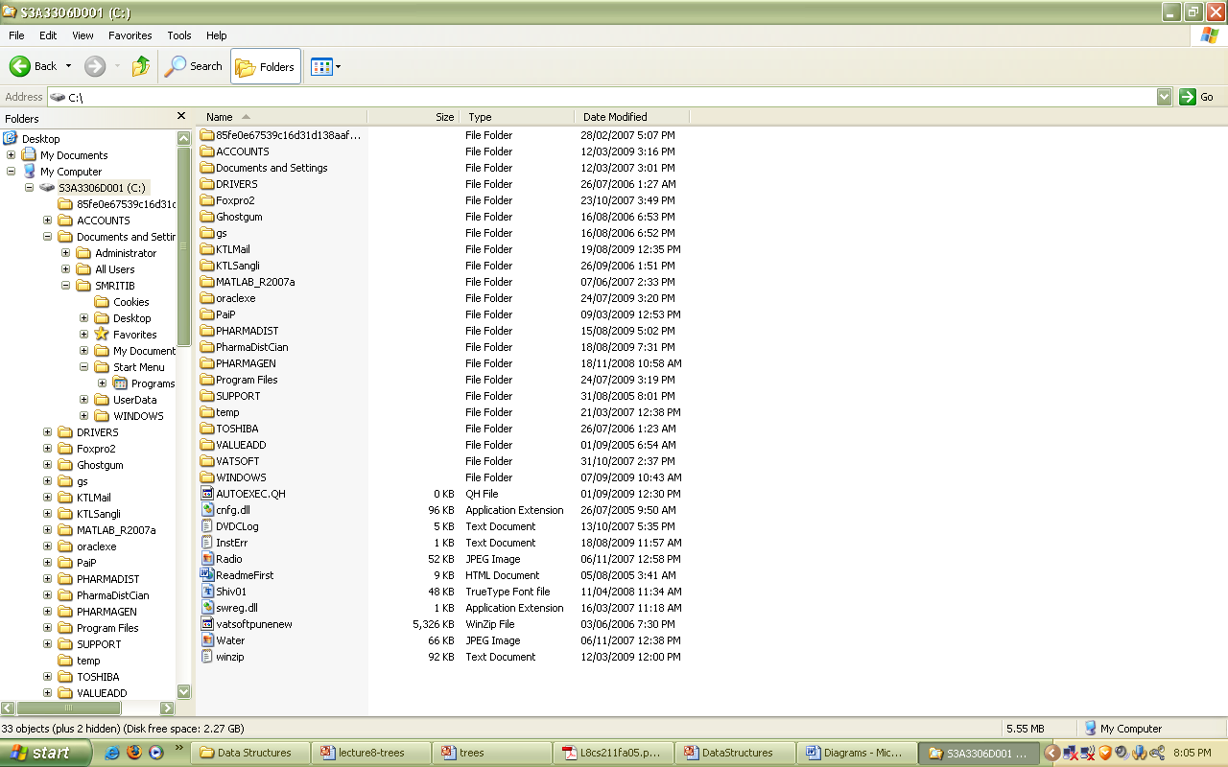

Slide 20
Indented List
301
  301-1
  301-2
    301-2-1
    301-2-2
  301-3
    301-3-1
      301-3-1-1
      301-3-1-2
    301-3-2
      301-3-2-1
      301-3-2-2
Computer
  Case
  CPU
    Controller
    ALU
  Memory
    Primary
      RAM
      ROM
    Secondary
      Floppy Disk
      CD-ROM

Slide 21
Parenthetical Listing
This format is used with algebraic expressions
Each open parenthesis ➔ start of new level
Each closing parenthesis ➔ completes the current level and moves up one level in the tree
A
B
E
F
C
D
G
H
I
A (B (C D) E F (G H I))

Slide 22
Ordered Tree
An ordered tree is a rooted tree in which the order of the children at every node is specified
If each node has no more than M children appearing in a specific order, then the tree is an M-ary tree
The simplest type of M-ary tree is the binary tree
Notes:
Ordered Tree
A tree where the children of each node have a designated order (not necessarily based on their value) and can be referred to specifically.

Slide 23
Binary Tree
A finite (possibly empty) collection of elements
A nonempty binary tree has a root element and the remaining elements (if any) are partitioned into two binary trees ➔ A node in a binary tree can have no more than two subtrees
They are called the left and right subtrees of the binary tree
Maximum outdegree for a node is two

Slide 24
Binary Tree - (2)
A
B
E
C
D
F
Left subtree
Right subtree

Slide 25
Binary Tree - (3)
A
A
A
B
B
(a)
(b)
(c)
(d)
A
A
A
A
B
C
B
C
B
B
(e)
D
E
C
C
(f)
(g)
(h)

Slide 26
Trees Vs Binary Trees
No node in a binary tree may have a degree more than 2, whereas there is no limit on the degree of a node in a tree.
The subtrees of a binary tree are ordered; those of a tree are not ordered.
A
A
- different when viewed as a binary tree
- same when viewed as a tree
B
C
C
B

Slide 27
Properties for binary trees
Height of Binary Trees
  Maximum Height
    If N nodes are in binary tree, then maximum height,
    H_{max} = N
  Minimum Height
    H_{min} = ⎣log₂N ⎦+ 1
  Example: If N = 3 then, H_{max} = 3 and H_{min} = 2

Slide 28
Properties for binary trees – (2)
  Minimum Nodes
    If H is height of the binary tree, the minimum number of nodes
    N_{min} = H
  Maximum Nodes
    If H is height of the binary tree, the maximum number of nodes
    N_{max} = 2^{H} – 1
  Example: If H = 3 then, N_{min} = 3 and N_{max} = 7

Slide 29
Properties for binary trees – (3)
Balance
  Balance factor
    It determines whether the tree is balanced
    It is the difference in height between its left and right subtrees
    If height of the left subtree is H_{L} and the height of the right subtree is H_{R}, the balance factor of the tree, B, is
        B = H_{L} - H_{R}
Notes:
The distance of a node from the root determines how efficiently it can be located.
To determine whether a tree is balanced, we calculate its balance factor.

Slide 30
Properties for binary trees – (4)
A
A
A
B
B
(a) B = 0
(b) B = 0
(c) B = 1
(d) B = -1
A
A
A
A
B
C
B
C
B
B
(e) B = 0
D
E
C
C
(f) B = 1
(g) B = -2
(h) B = 2

Slide 31
Balanced Binary Tree
Balanced binary tree
  The height of its subtrees differ by no more than one (its balance factor is -1, 0 or 1), and
  Its subtrees are also balanced

Slide 32
Complete Trees
A complete tree has the maximum number of entries for its height
The maximum number is reached when the last level is full

Slide 33
Complete Trees – (2)
A
A
A
B
C
B
C
Level 0
Level 1
D
E
F
G
Level 2

Slide 34
Nearly complete Trees
A nearly complete tree has the minimum height for its nodes
All the nodes in the last level are found on the left

Slide 35
Nearly complete Trees – (2)
A
A
A
B
C
B
C
B
C
D
D
D
E
F
E
Level 2
Level 2
Level 2

Slide 36
Representing Binary Trees in Memory
Linked Representation
  Using three parallel arrays
  Using linked lists
Sequential Representation using single array
Notes:
The main requirement of any representation of tree T is that one should have direct access to the root R of T and, given any node N of T, one should have direct access to the children of N.

Slide 37
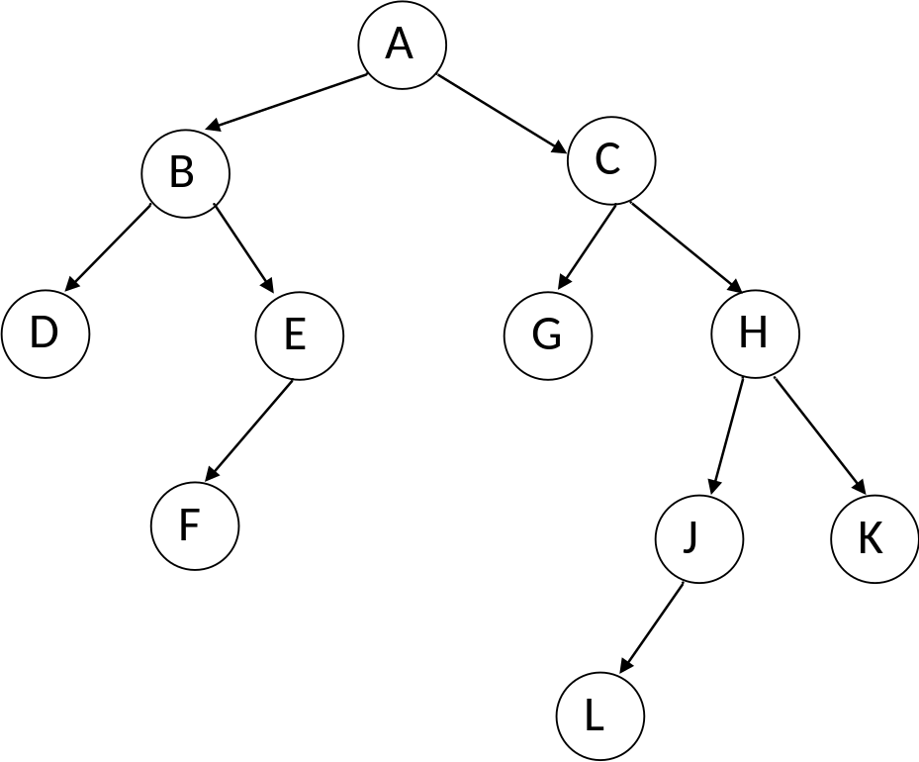
Representing Binary Trees in Memory
Index | Info |  | Left |  | Right
0 | K |  | -1 |  | -1
1 | C |  | 2 |  | 5
2 | G |  | -1 |  | -1
3
4 | A |  | 9 |  | 1
5 | H |  | 14 |  | 0
6 | L |  | -1 |  | -1
7
8
9 | B |  | 13 |  | 12
10
11 | F |  | -1 |  | -1
12 | E |  | 11 |  | -1
13 | D |  | -1 |  | -1
14 | J |  | 6 |  | -1
Linked representation using three parallel arrays
Root

Slide 38
Representing Binary Trees in Memory
Linked representation using linked list
ROOT
A
B
C
X D X
E X
X G X
H
X F X
J X
X K X
X L X

Slide 39
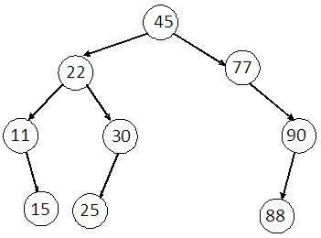
Representing Binary Trees in Memory
Index | TREE
1 | 45
2 | 22
3 | 77
4 | 11
5 | 30
6
7 | 90
8
9 | 15
10 | 25
11
12
13
14 | 88
15
29
Sequential representation using single array
  The root R of tree is stored in TREE [1]
  If a node N occupies TREE[K], then its left child is stored in TREE[2*K] and its right child is stored in TREE[2*K+1]
Efficient if binary tree is complete or nearly complete

Slide 40
Binary Tree Traversals
Many binary tree operations are done by performing a traversal of the binary tree.
In a traversal, each element of the binary tree is visited and processed exactly once in a predetermined sequence.

Slide 41
Binary Tree Traversals – (2)
Two general approaches to traversal
  Depth-first traversal
  Breadth-first traversal

Slide 42
Binary Tree Traversals – (3)
Depth-first traversal
  Processing proceeds along a path from the root through one child to the most distant descendent of that first child before processing a second child
  Process all of the descendents of a child before going on to the next child

Slide 43
Binary Tree Traversals – (4)
Breadth-first traversal
  Processing proceeds horizontally from the root to all of its children, then to its children’s children and so forth until all the nodes have been processed
  Each level is completely processed before the next level is started

Slide 44
Depth-first Traversal
Preorder
  The root of the subtree is processed first, followed by the left subtree and then the right subtree (root, left, right).
Inorder
  After the complete processing of the left subtree the root is processed followed by the processing of the complete right subtree (left, root, right).
Postorder
  The root is processed only after the complete processing of the left and right subtrees (left, right, root).

Slide 45
Depth-first Traversal
1
2
3
2
3
1
3
1
2
Left
subtree
Right
subtree
Left
subtree
Right
subtree
Left
subtree
Right
subtree
Preorder traversal
Inorder traversal
Postorder traversal
The root is processed first followed by left subtree and then right subtree
Root is processed first before its subtrees
(root, left, right)
The left subtree is processed first, then the root and finally the right subtree
Root is processed between its subtrees
(left, root, right)
The root is processed after (post) the left and right subtrees have been processed
Root is processed after its subtrees
(left, right, root)

Slide 46
Recursive algorithm for Preorder traversal
Algorithm preOrder(root)
//Traverse a binary tree in root-left-right sequence.
if (root is not null)
process (root)
preOrder(leftSubtree)
preOrder(rightSubtree)
end if
End preOrder

Slide 47
Preorder Traversal
A
B
E
C
D
F

Slide 48
Preorder Traversal
A
B
E
C
D
F

Slide 49
Preorder Traversal
A
B
E
C
D
F

Slide 50
Preorder Traversal
A
B
E
C
D
F

Slide 51
Preorder Traversal
A
B
E
C
D
F

Slide 52
Preorder Traversal
A
B
E
C
D
F

Slide 53
Preorder Traversal
A
B
E
C
D
F

Slide 54
Preorder Traversal
A
B
E
C
D
F

Slide 55
Preorder Traversal
A
B
E
C
D
F
A
B
C
D
E
F
Processing Order in Preorder Traversal : A B C D E F

Slide 56
Recursive algorithm for Inorder traversal
Algorithm inOrder(root)
//Traverse a binary tree in left-root-right sequence.
if (root is not null)
inOrder(leftSubtree)
process (root)
inOrder(rightSubtree)
end if
End inOrder

Slide 57
Inorder Traversal
A
B
E
C
D
F

Slide 58
Inorder Traversal
A
B
E
C
D
F

Slide 59
Inorder Traversal
A
B
E
C
D
F

Slide 60
Inorder Traversal
A
B
E
C
D
F

Slide 61
Inorder Traversal
A
B
E
C
D
F

Slide 62
Inorder Traversal
A
B
E
C
D
F

Slide 63
Inorder Traversal
A
B
E
C
D
F

Slide 64
Inorder Traversal
A
B
E
C
D
F

Slide 65
Inorder Traversal
A
B
E
C
D
F
C
B
D
A
E
F
Processing Order in Inorder Traversal : C B D A E F

Slide 66
Recursive algorithm for Postorder traversal
Algorithm postOrder(root)
//Traverse a binary tree in left-right-root sequence.
if (root is not null)
postOrder(leftSubtree)
postOrder(rightSubtree)
process (root)
end if
End postOrder

Slide 67
Postorder Traversal
A
B
E
C
D
F

Slide 68
Postorder Traversal
A
B
E
C
D
F

Slide 69
Postorder Traversal
A
B
E
C
D
F

Slide 70
Postorder Traversal
A
B
E
C
D
F

Slide 71
Postorder Traversal
A
B
E
C
D
F

Slide 72
Postorder Traversal
A
B
E
C
D
F

Slide 73
Postorder Traversal
A
B
E
C
D
F

Slide 74
Postorder Traversal
A
B
E
C
D
F

Slide 75
Postorder Traversal
A
B
E
C
D
F
C
D
B
F
E
A
Processing Order in Postorder Traversal : C D B F E A

Slide 76
Non-Recursive algorithm for Preorder traversal
Algorithm PreOrderNR(root)
//Traverse a binary tree in root-left-right sequence.
createStack(stack)
set ptr to root
loop (ptr not null)
process (ptr)
//Test existence of right child
if (ptr rchild not null)
pushStack(stack, ptr rchild)
end if
//Test existence of left child
if (ptr lchild not null)
set ptr to ptr lchild
else
set ptr to popStack(stack)
end if
end loop
End PreOrderNR

Slide 77
Non-Recursive algorithm for Inorder traversal
Algorithm InOrderNR(root)
//Traverse a binary tree in left-root-right sequence.
createStack(stack)
set ptr to root
//Visit left child
Rstep: loop (ptr not null)
pushStack (ptr)
set ptr to ptr lchild
end loop
set ptr to popStack(stack)
//Backtracking
loop (ptr not null)
process (ptr)
if (ptr rchild not null)
set ptr to ptr rchild
go to Rstep
end if
set ptr to popStack(stack)
end loop
End InOrderNR

Slide 78
Non-Recursive algorithm for Postorder traversal
Algorithm PostOrderNR(root)
//Traverse a binary tree in left-right-root sequence.
createStack(stack)
set ptr to root
Rstep: loop (ptr not null)
pushStack (ptr)
if (ptr rchild not null)
pushStack(- ptr rchild)
end if
set ptr to ptr lchild
end loop
set ptr to popStack(stack)
loop (ptr > 0)
process(ptr)
set ptr to popStack(stack)
end loop
if (ptr < 0)
set ptr to – ptr
go to Rstep
end if
End PostOrderNR

Slide 79
Breadth-first tree Traversal
Algorithm breadthFirst(root)
//Process tree using breadth-first traversal
set currentNode to root
createQueue(bfQueue)
loop (currentNode not null)
process(currentNode)
if (left subtree not null)
enqueue(bfQueue, left subtree)
end if
if (right subtree not null)
enqueue(bfQueue, right subtree)
end if
if (not emptyQueue(bfQueue))
set currentNode to dequeue(bfQueue)
else
set currentNode to null
end if
end loop
destroyQueue(bfQueue)
End breadthFirst

Slide 80
Breadth-first tree Traversal
A
B
E
C
D
F

Slide 81
Breadth-first tree Traversal
A
B
E
C
D
F

Slide 82
Breadth-first tree Traversal
A
B
E
C
D
F

Slide 83
Breadth-first tree Traversal
A
B
E
C
D
F

Slide 84
Breadth-first tree Traversal
A
B
E
C
D
F

Slide 85
Breadth-first tree Traversal
A
B
E
C
D
F

Slide 86
Breadth-first tree Traversal
A
B
E
C
D
F

Slide 87
Breadth-first tree Traversal
A
B
E
C
D
F

Slide 88
Breadth-first tree Traversal
A
B
E
C
D
F
Processing Order in Breadth-first Traversal : A B E C D F

Slide 89
Expression Trees
Interesting application of binary trees
An expression tree is a binary tree with following properties
  Each leaf is an operand
  The root and internal nodes are operators
  Subtrees are subexpressions, with the root being an operator
Notes:
An expression is a sequence of tokens that follow prescribed rules. A token may be either an operand or an operator. In this discussion we consider only binary arithmetic operators in the form operand – operator – operand. The standard arithmetic operators are +, -, *, and /.

Slide 90
Expression Trees – (2)
+
x
d
a
+
a x (b + c) + d
b
c

Slide 91
Expression Trees – (3)
Inorder Traversal ➔ Infix expression
Postorder Traversal ➔ Postfix expression
Preorder Traversal ➔ Prefix expression

Slide 92
Infix Traversal
Algorithm infix (tree)
//Print the infix expression for an expression tree
//tree is a pointer to an expression tree
if (tree not empty)
if (tree token is an operand)
print(tree-token)
else
print(open parenthesis)
infix(tree left subtree)
print(tree token)
infix(tree right subtree)
print(close parenthesis)
end if
end if
End infix

Slide 93
Infix Traversal – (2)
Add an opening parenthesis at the beginning of each expression
Add a closing parenthesis at the end of each expression
Print the opening parenthesis when we start a tree or subtree
Print the closing parenthesis when we have processed all of its children
(left, root, right)
(
+
)
(
x
)
d
a
(
+
)
((a x (b + c)) + d)
b
c

Slide 94
Postfix Traversal
Algorithm postfix (tree)
//Print the postfix expression for an expression tree
//tree is a pointer to an expression tree
if (tree not empty)
postfix(tree left subtree)
postfix(tree right subtree)
print(tree token)
end if
End postfix

Slide 95
Postfix Traversal
(left, right, root)
+
x
d
a
+
a b c + x d +
b
c

Slide 96
Prefix Traversal
Algorithm prefix (tree)
//Print the prefix expression for an expression tree
//tree is a pointer to an expression tree
if (tree not empty)
print(tree token)
prefix(tree left subtree)
prefix(tree right subtree)
end if
End prefix

Slide 97
Prefix Traversal
(root, left, right)
+
x
d
a
+
+ x a + b c d
b
c

Slide 98
General Trees
Each node can have an unlimited outdegree
Each node may have as many children as is necessary to satisfy its requirements

Slide 99
Converting General Trees to Binary Trees
Representing binary trees in programs is easier than representing general trees
In general tree, we use two relationships:
  Parent to child
  Sibling to sibling
Using these relationships, we can represent any general tree as a binary tree

Slide 100
Converting General Trees to Binary Trees
A
B
E
F
C
D
G
H
I

Slide 101
Converting General Trees to Binary Trees
A
A
B
E
F
B
E
F
C
D
G
H
I
C
D
G
H
I
Identify leftmost children
Connect siblings
A
A
B
C
E
B
E
F
D
F
G
C
D
G
H
I
H
Delete unneeded branches
I
Resulting Binary Tree

Slide 102
Exercise – (1)
Show the tree representation of the following parenthetical notation
A ( B (C (D E) F) G H (I J) )
A
B
G
H
C
F
I
J
D
E

Slide 103
Exercise – (2)
Find
  Root
  Leaves
  Internal nodes
  Ancestors of H
  Descendents of F
  Indegree of F
  Outdegree of B
  Siblings of H
  Parents of K
  Children of C
  {A}
  {D E H L J}
  {B F C G I K}
  {A F G}
  {G H I K L J}
  1
  1
  {I J}
  {I}
  {D E}
A
B
F
C
G
D
E
H
I
J
K
L

Slide 104
Exercise – (2)
Find
  Height of the tree
  6
  Height of subtree G
  4
  Level of node G
  2
  Level of node A
  0
  Height of subtree E
  1
A
B
F
C
G
D
E
H
I
J
K
L

Slide 105
Exercise – (2)
Show the subtrees of Node F
A
B
F
C
G
D
E
H
I
J
K
L

Slide 106
Exercise – (2)
Show the indented list representation of the tree
A
A
  B
    C
      D
      E
  F
    G
      H
      I
        K
        ▪ L
      J
B
F
C
G
D
E
H
I
J
K
L

Slide 107
Exercise – (2)
Show the parenthetical representation of the tree
A
B
F
A (B (C (D E)) F (G (H I (K (L)) J)) )
C
G
D
E
H
I
J
K
L

Slide 108
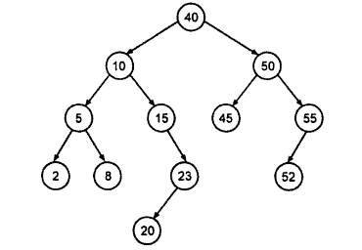
Exercise – (3)
Preorder Traversal
  40,10,5,2,8,15,23,20,50,45,55,52
Inorder Traversal
  2,5,8,10,15,20,23,40,45,50,52,55
Postorder Traversal
  2,8,5,20,23,15,10,45,52,55,50,40

Slide 109
Exercise – (4)
In a binary tree, what is the maximum number of nodes that can be found?
  In Level 3
  8
  In Level 4
  16
  In Level 12
  4096

Slide 110
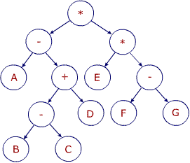
Exercise – (5)
Consider Binary Expression Tree
Prefix Notation
  * - A + - B C D * E - F G
Infix Notation
  ((A – ((B-C)+D)) * (E * (F-G)))
Postfix Notation
  A B C - D + - E F G - * *

Slide 111
Exercise – (6)
Consider Binary Expression Tree
*
+
/
a
-
-
-
b
c
d
e
+
h
f
g

Slide 112
Exercise – (6)
(
*
)
(
+
)
(
/
)
a
(
-
)
(
-
)
(
-
)
b
c
d
e
(
+
)
h
f
g
  Infix Notation
  ( (a+ (b-c) ) * ( (d-e) / ((f+g)-h) ) )

Slide 113
Exercises – (6)
Prefix Notation
* + a – b c / - d e - + f g h
Postfix Notation
a b c - + d e – f g + h - / *
*
+
/
a
-
-
-
b
c
d
e
+
h
f
g

Slide 114
Exercise – (7)
A binary tree T has 9 nodes. The inorder and preorder traversals of T yield the following sequences of nodes:
  Inorder: E A C K F H D B G
  Preorder: F A E K C D H G B
Draw the tree

Slide 115
Exercise – (7)
  Inorder:
  E A C K F H D B G
  Preorder:
  F A E K C D H G B
F
A
D
E
K
H
G
C
B

Slide 116
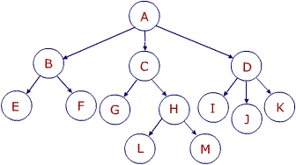
Exercise – (8)
Convert General Tree into the Binary Tree

Slide 117
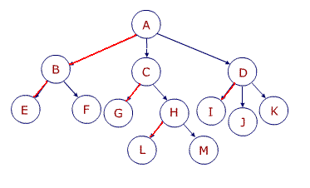
Exercise – (8)
Step 1 : Identify leftmost children

Slide 118
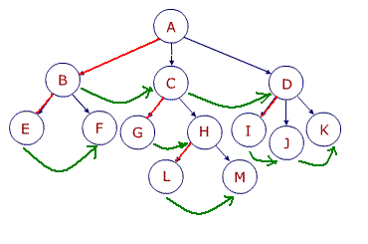
Exercise – (8)
Step 2 : Connect siblings

Slide 119
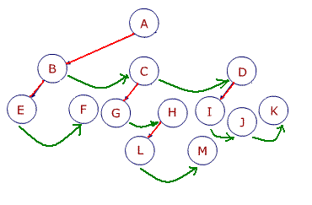
Exercise – (8)
Step 3 : Delete unneeded branches

Slide 120
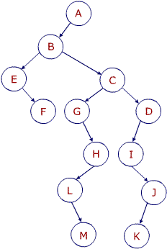
Exercise – (8)
Step 4 : Resulting Binary Tree

Slide 121
Exercise – (9)
Convert General Tree into the Binary Tree
A
B
C
D
E
F
G
H
J
K
L
M
N

Slide 122
Exercise – (9)
A
Binary Tree
B
E
C
F
G
D
H
K
L
J
M
N

Slide 123
Binary Search Trees
Notes:
BST is used when data needs to be ordered.
In the design of the linear list, we had two choices: an array or a linked list. The array structure provides a very efficient search algorithm, the binary search, but its insertion and deletion algorithms are very inefficient.
On the other hand, the linked list structure provides efficient insertion and deletion, but its search algorithm is very inefficient.
What we need is a structure that provides an efficient search algorithm and at the same time efficient insert and delete algorithms.
The binary search tree and the AVL tree provide that structure.
[AVL trees are balanced whereas binary search trees are not.]

Slide 124
The Concept
A Binary Search Tree (BST) is a binary tree with the following properties:
  All items in the left subtree are less than the root
  All items in the right subtree are greater than or equal to the root
  Each subtree is itself a binary search tree

Slide 125
Binary Search Tree
K
All < K
All ≥ K

Slide 126
Binary Search Tree - Examples
17
17
6
19
(a) Complete and Balanced
(b) Complete and Balanced
17
17
17
6
6
19
19
3
3
14
22
(c) Neither Complete nor Balanced
(d) Nearly Complete and Balanced
(e) Neither Complete nor Balanced

Slide 127
Examples
17
17
22
19
6
11
(b)
All are invalid binary search trees
(a)
17
17
6
19
6
19
11
15
3
22
(c)
(d)

Slide 128
BST Operations - Traversals
Preorder traversal
23,18,12,20,44,35,52
Postorder traversal
12,20,18,35,52,44,23
Inorder traversal
12,18,20,23,35,44,52
23
18
44
12
20
35
52
Inorder traversal of a BST produces a sequenced list

Slide 129
Searches
Three search algorithms
  Find the smallest node
  Find the largest node
  Find a requested node

Slide 130
Find Smallest Node in BST
Node with the smallest value (12) is the far-left leaf node in the tree
Follow the left branches in the tree until the leaf node is reached
23
18
44
12
20
35
52

Slide 131
Find Smallest Node in BST –(2)
Algorithm findSmallestBST (root)
//Finds the smallest node in a BST
//root is a pointer to a nonempty BST or subtree
// Returns address of smallest node
if (left subtree empty)
return (root)
end if
return findSmallestBST (left subtree)
End findSmallestBST

Slide 132
Find Smallest Node in BST –(3)
Left Subtree not Empty
23
Left Subtree not Empty
18
44
Left Subtree Empty - Return
12
20
35
52

Slide 133
Find Largest Node in BST
Node with the largest value (52) is the far-right leaf node in the tree
Follow the right branches in the tree until the leaf node is reached
23
18
44
12
20
35
52

Slide 134
Find Largest Node in BST
Algorithm findLargestBST (root)
//Finds the largest node in a BST
//root is a pointer to a nonempty BST or subtree
// Returns address of largest node
if (right subtree empty)
return (root)
end if
return findLargestBST (right subtree)
End findLargestBST

Slide 135
Search BST
Compare 20 with root 23
Searching the given node in the BST
E.g. Search node 20.
Compare 20 with left subtree 18
23
18
44
12
20
35
52

Slide 136
Search BST – (2)
Algorithm searchBST (root, targetKey)
// Searches the BST for a given value
// root is the root of tree or subtree
// targetKey is the key value requested
// Returns the node address if the value is found else returns null
if (empty tree)
return null
end if
if (targetKey < root)
return searchBST (left subtree, targetKey)
else if (targetKey > root)
return searchBST (right subtree, targetKey)
else
return root // found target key
endif
End searchBST

Slide 137
Insertion
Add data to a BST
To add data to BST
  Follow the branches to an empty subtree
  Insert the new node
All inserts take place at a leaf or at a leaflike node

Slide 138
Insertion – (2)
Add Node 19
Add Node 38
23
18
44
12
20
35
52
19
38

Slide 139
Insertion – (3)
Algorithm addBST (root, newNode)
// Inserts node containing new data into BST using recursion
// root is the address of current node in BST
// newNode is address of node containing data
// Returns the address of new tree root
if (empty tree)
set root to newNode
return newNode
end if
// Locate null subtree for insertion
if (newNode data < root data)
return addBST (left subtree, newNode)
else
return addBST (right subtree, newNode)
end if
End addBST

Slide 140
Deletion
Delete a node from BST
To delete a node
  Locate the node
  Four possible cases
    The node to be deleted has no children ➔ delete the node
    The node to be deleted has only a right subtree ➔ delete the node and attach the right subtree to the deleted node’s parent
    The node to be deleted has only a left subtree ➔ delete the node and attach the left subtree to the deleted node’s parent
    The node to be deleted has two subtrees ➔ the result tends to create very unbalanced trees

Slide 141
Deletion – (2)
The node to be deleted has two subtrees ➔ try to maintain the existing structure as much as possible by finding the data to take place of the deleted data
  Find the largest node in the deleted node’s left subtree and move its data to replace the deleted node’s data
  OR
  Find the smallest node on the deleted node’s right subtree and move its data to replace the deleted node’s data

Slide 142
Deletion – (4)
17
Original tree
Locate the node to be deleted
Find largest key on left subtree
Move largest data
Delete the largest node
9
23
17
Node to be deleted
5
11
21
27
Move largest data here
9
20
22
23
5
11
21
27
Delete this node
22
20
22
Find the largest key on left subtree

Slide 143
Deletion – (3)
Algorithm deleteBST (root, dltKey)
// Deletes a node from BST
// root is reference to the node to be deleted
// dltKey is the key of node to be deleted
// if dltKey not found, root unchanged
// Returns true if node deleted, false if not found
if (empty tree)
return false
end if
if (dltKey < root data)
return deleteBST (left subtree, dltKey)
else if (dltKey > root data)
return deleteBST (right subtree, dltKey)
else
// Delete node found – test for leaf node
If (no left subtree)
make right subtree the root
return true
else if (no right subtree)
make left subtree the root
return true
else
// Node to be deleted not a leaf. Find largest node on left subtree
save root in deleteNode
set largest to largestBST (left subtree)
move data in largest to deleteNode
return deleteBST (left subtree of deleteNode, key of largest)
end if
end if
End deleteBST

Slide 144
Exercise - 1
Add Node 33
60
30
70
20
55
90
35
80
95
33
45
40
50

Slide 145
Exercise - 2
Suppose the Following list of letters is inserted in order into an empty binary search tree : J, R, D, G, T, E, M, H, P, A, F, Q
  Find the final tree
  Find the inorder traversal of tree
Inorder Traversal
A, D, E, F, G, H, J, M, P, Q, R, T
J
D
R
A
G
M
T
E
H
P
F
Q

Slide 146
Exercise - 3
Delete node M
Delete node D
J
J
D
R
E
R
A
G
M
T
A
G
P
T
E
H
P
F
H
Q
F
Q

Slide 147
Exercise - 4
Draw all possible binary search trees for the data elements 5, 9 and 12
12
12
5
5
9
5
9
12
5
9
12
9
9
5
12

Slide 148
Exercise - 5
Create a BST using the following data entered as a sequential set:
  14, 23, 7, 10, 33, 56, 80, 66, 70
  7, 10, 14, 23, 33, 56, 66, 70, 80
  80, 70, 66, 56, 33, 23, 14, 10, 7
Insert 44 and 50 into the above trees

Slide 149
Implementation

Slide 150
Representing Binary Trees
Linked Representation of Binary Trees
Sequential Representation of Binary Tree

Slide 151
Linked Representation
Consider binary tree T
Use three parallel arrays : INFO, LEFT, RIGHT
Use a pointer variable ROOT

Slide 152
Linked Representation – (2)
Each node N of T will correspond to a location K such that
  INFO[K] contains data at node N
  LEFT[K] contains the location of the left child of node N
  RIGHT[K] contains the location of the right child of node N
ROOT ➔ location of the root R of T
If any subtree is empty ➔ corresponding pointer will contain null value
If tree T is empty ➔ ROOT will contain the null value

Slide 153
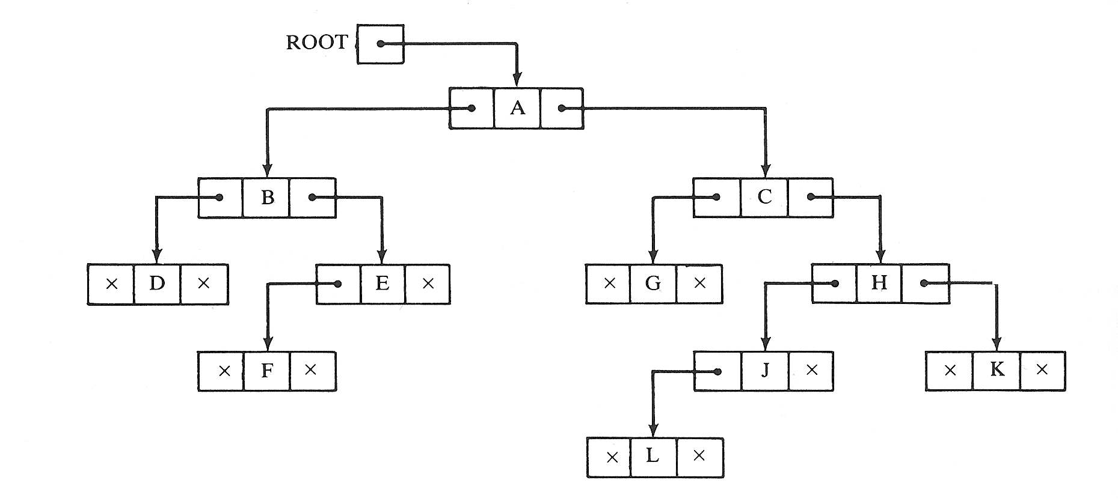
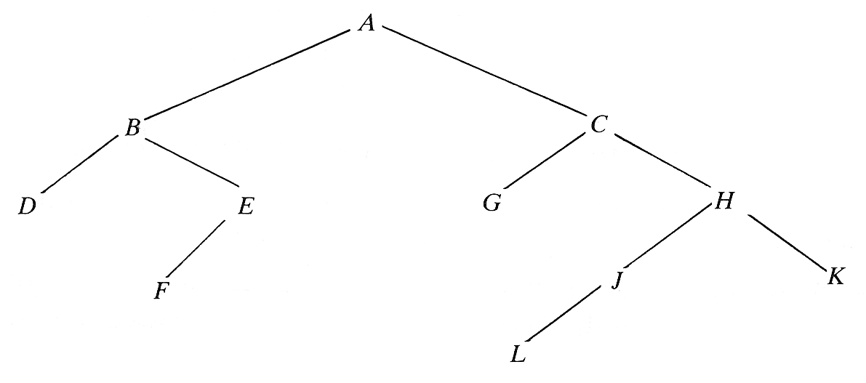
Linked Representation – (3)

Slide 154
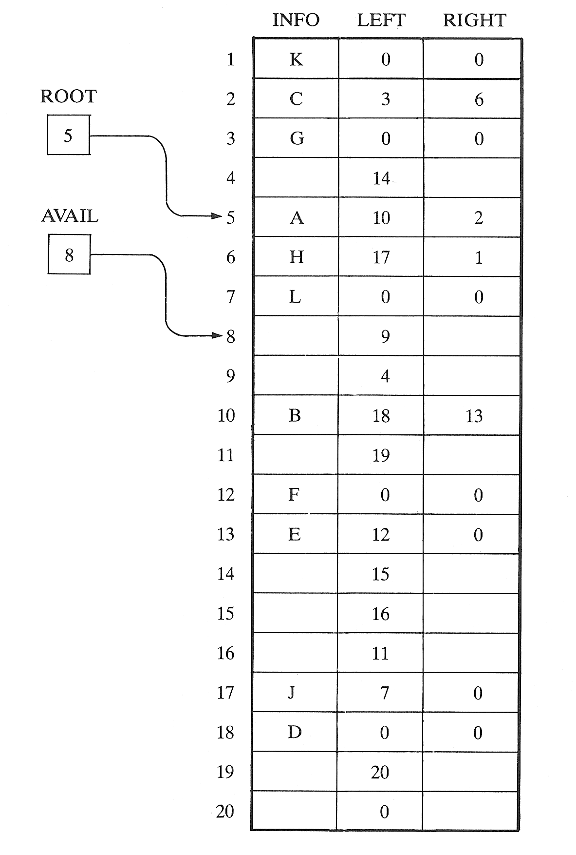
Linked Representation – (4)

Slide 155
Sequential Representation
Efficient for complete or nearly complete
Uses only a single linear array TREE as follows:
  The root R of T is stored in TREE[1]
  If a node N occupies TREE[K], then its left child is stored in TREE[2*K] and its right child is stored in TREE[2*K+1]
  NULL – used to indicate an empty subtree

Slide 156
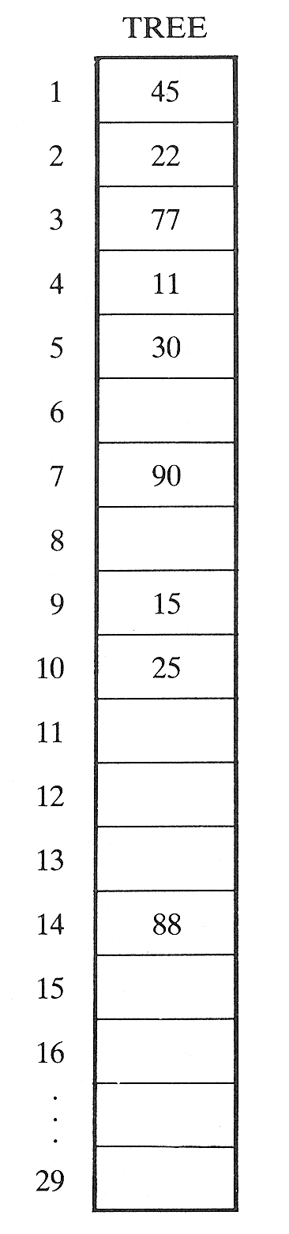
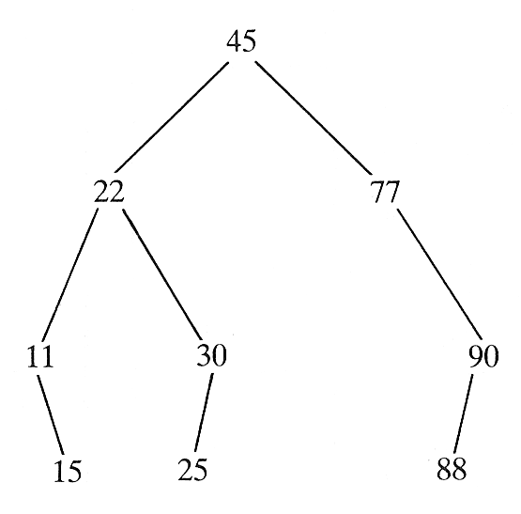
Sequential Representation – (2)

Slide 157
Program in C to implement BST and Tree Traversals
struct btreenode
{
struct btreenode *LEFT;
int INFO;
struct btreenode *RIGHT;
}

Slide 158
main( )
{
struct btreenode *bt;
int req, i, num;
bt=NULL; /*empty tree*/
clrsrc();
printf(“Specify the number of nodes to be inserted:”);
scanf(“%d”,&req);
while(i++<=req)
{
printf(“Enter the data:”);
scanf(“%d”,&num);
insert(&bt, num);
}
clrscr();
printf(“\nInorder Traversal: “);
inorder(bt);
printf(“\nPreorder Traversal: “);
preorder(bt);
printf(“\nPostorder Traversal: “);
postorder(bt);
}

Slide 159
/* Insert new node in a BST */
insert(struct btreenode **sr, int num)
{
If (*sr==NULL)
{
*sr=malloc (sizeof(struct btreenode));
(*sr)->LEFT = NULL;
(*sr)->INFO = num;
(*sr)->RIGHT = NULL;
return;
}
else /* search the node to which new node will be attached */
{
/* if new data is less than current node, traverse to left */
if (num < (*sr) -> INFO)
insert(&((*sr)->LEFT),num);
else
/* else traverse to right */
insert(&((*sr)->RIGHT),num);
}
return;
}

Slide 160
/* Traverse BST in Left-Root-Right fashion */
inorder (struct btreenode *sr)
{
if (sr != NULL)
{
inorder(sr->LEFT);
/* Print the data of the node whose left child is NULL or the path has already been traversed */
printf(“%d”,sr->INFO);
inorder(sr->RIGHT);
}
else
return;
}

Slide 161
/* Traverse BST in Root-Left-Right fashion */
preorder (struct btreenode *sr)
{
if (sr != NULL)
{
/* Print data of a node */
printf(“%d”,sr->INFO);
/* Traverse till left child is not NULL */
preorder(sr->LEFT);
/* Traverse till right child is not NULL */
preorder(sr->RIGHT);
}
else
return;
}

Slide 162
/* Traverse BST in Left-Right-Root fashion */
postorder (struct btreenode *sr)
{
if (sr != NULL)
{
postorder(sr->LEFT);
postorder(sr->RIGHT);
/* Print data of a node */
printf(“%d”,sr->INFO);
}
else
return;
}

Slide 163
Deletion from BST
#define TRUE 1
#define FALSE 0
main()
{
struct btreenode *bt;
int req, i=0, num, a[]={11,9,13,8,10,12,14,15,7};
bt = NULL; /* empty tree */
clrscr();
while (i<=8)
{
insert (&bt, a[i]);
i++;
}
clrscr();
printf(“Binary tree before deletion: ”);
inorder(bt);
delete (&bt, 10);
printf(“Binary tree after deletion: ”);
inorder(bt);
delete (&bt, 14);
printf(“Binary tree after deletion: ”);
inorder(bt);
delete (&bt, 8);
printf(“Binary tree after deletion: ”);
inorder(bt);
delete (&bt, 13);
printf(“Binary tree after deletion: ”);
inorder(bt);
}

Slide 164
/* deletes a node from the BST */
delete (struct btreenode ** root, int num)
{
int found;
struct btreenode *parent, *x, *xsucc;
/* if tree is empty */
if (*root == NULL)
{
printf(“\nTree is empty”);
return;
}
parent = x = NULL;
/* Call to search function to find the node to be deleted */
search (root, num, &parent, &x, & found);
/* if the node to be deleted is not found */
if (found == FALSE)
{
printf(“\nData to be deleted not found”);
return;
}

Slide 165
/* if the node to be deleted has no child*/
if (x->LEFT==NULL && x->RIGHT==NULL)
{
if (parent->RIGHT==x)
parent->RIGHT = NULL;
else
parent->LEFT = NULL;
free (x);
return;
}

Slide 166
/* if the node to be deleted has only right child*/
if (x->LEFT==NULL && x->RIGHT!=NULL)
{
if (parent->LEFT==x)
parent->LEFT = x->RIGHT;
else
parent->RIGHT = x->RIGHT;
free (x);
return;
}

Slide 167
/* if the node to be deleted has only left child*/
if (x->LEFT!=NULL && x->RIGHT==NULL)
{
if (parent->LEFT==x)
parent->LEFT = x->LEFT;
else
parent->RIGHT = x->LEFT;
free (x);
return;
}

Slide 168
/* if the node to be deleted has two children */
if (x->LEFT!=NULL && x->RIGHT!=NULL)
{
parent = x;
xsucc = x->RIGHT;
while (xsucc-> LEFT != NULL)
{
parent=xsucc;
xsucc=xsucc->LEFT;
}
x->INFO=xsucc->INFO;
x=xsucc;
}
}

Slide 169
/* returns the address of the node to be deleted, address of its parent and whether the node is found or not */
search(struct btreenode **root, int num, struct btreenode **par, struct btreenode **x, int *found)
{
struct btreenode *q;
q=*root;
*found = FALSE;
*par = NULL;
while (q!=NULL)
{
/* if the node to be deleted is found */
if (q->INFO == num)
{
*found = TRUE;
*x = q;
return;
}
if (q->INFO > num)
{
*par=q;
q=q->LEFT;
}
else
{
*par=q;
q=q->RIGHT;
}
}
}

Slide 170
WCE - SY (CSE) – CS 212: Data Structures and Files
Subject Teacher: Smriti Bhandari

